Slide 1

SEBBY’S CORNER
So no child goes without

Slide 2
SEBBY’S CORNER
So no child goes without
About Us
​
Where are we based?
We are based in Barnet EN5 and support families across Barnet, Hertfordshire, Greater London and the Home Counties.
Who do we help?
We support families living in poverty, families in temporary accommodation, families who have fled domestic abuse, refugees, asylum seekers and victims of modern slavery and human trafficking. We provide items as clothing, nappies, formula, toiletries and baby equipment.

Slide 3


Essential Support
We support families with essential items for their children such as nappies, formula, clothing, baby equipment and toys.
Families in need of support can be referred to us by a registered referral partner.
The family or referral partner can attend the appointment at our hub in Barnet.
Each family is entitled to a total of 3 essential support referrals.
The items you have selected on your referral form will be thoughtfully packed by our wonderful volunteers. We will do our best to pack all the items requested but as we rely heavily on donations, we can’t guarantee the family will receive all the items they have requested.
You as the referral partner or the family themselves can collect the items. Please note we do not deliver items.
Please help us by informing all families that they will need to arrange suitable transportation to take the items home, as we are unable to provide transport.The families will hopefully be leaving with a large quantity of items, public transport is not recommended.

Slide 4
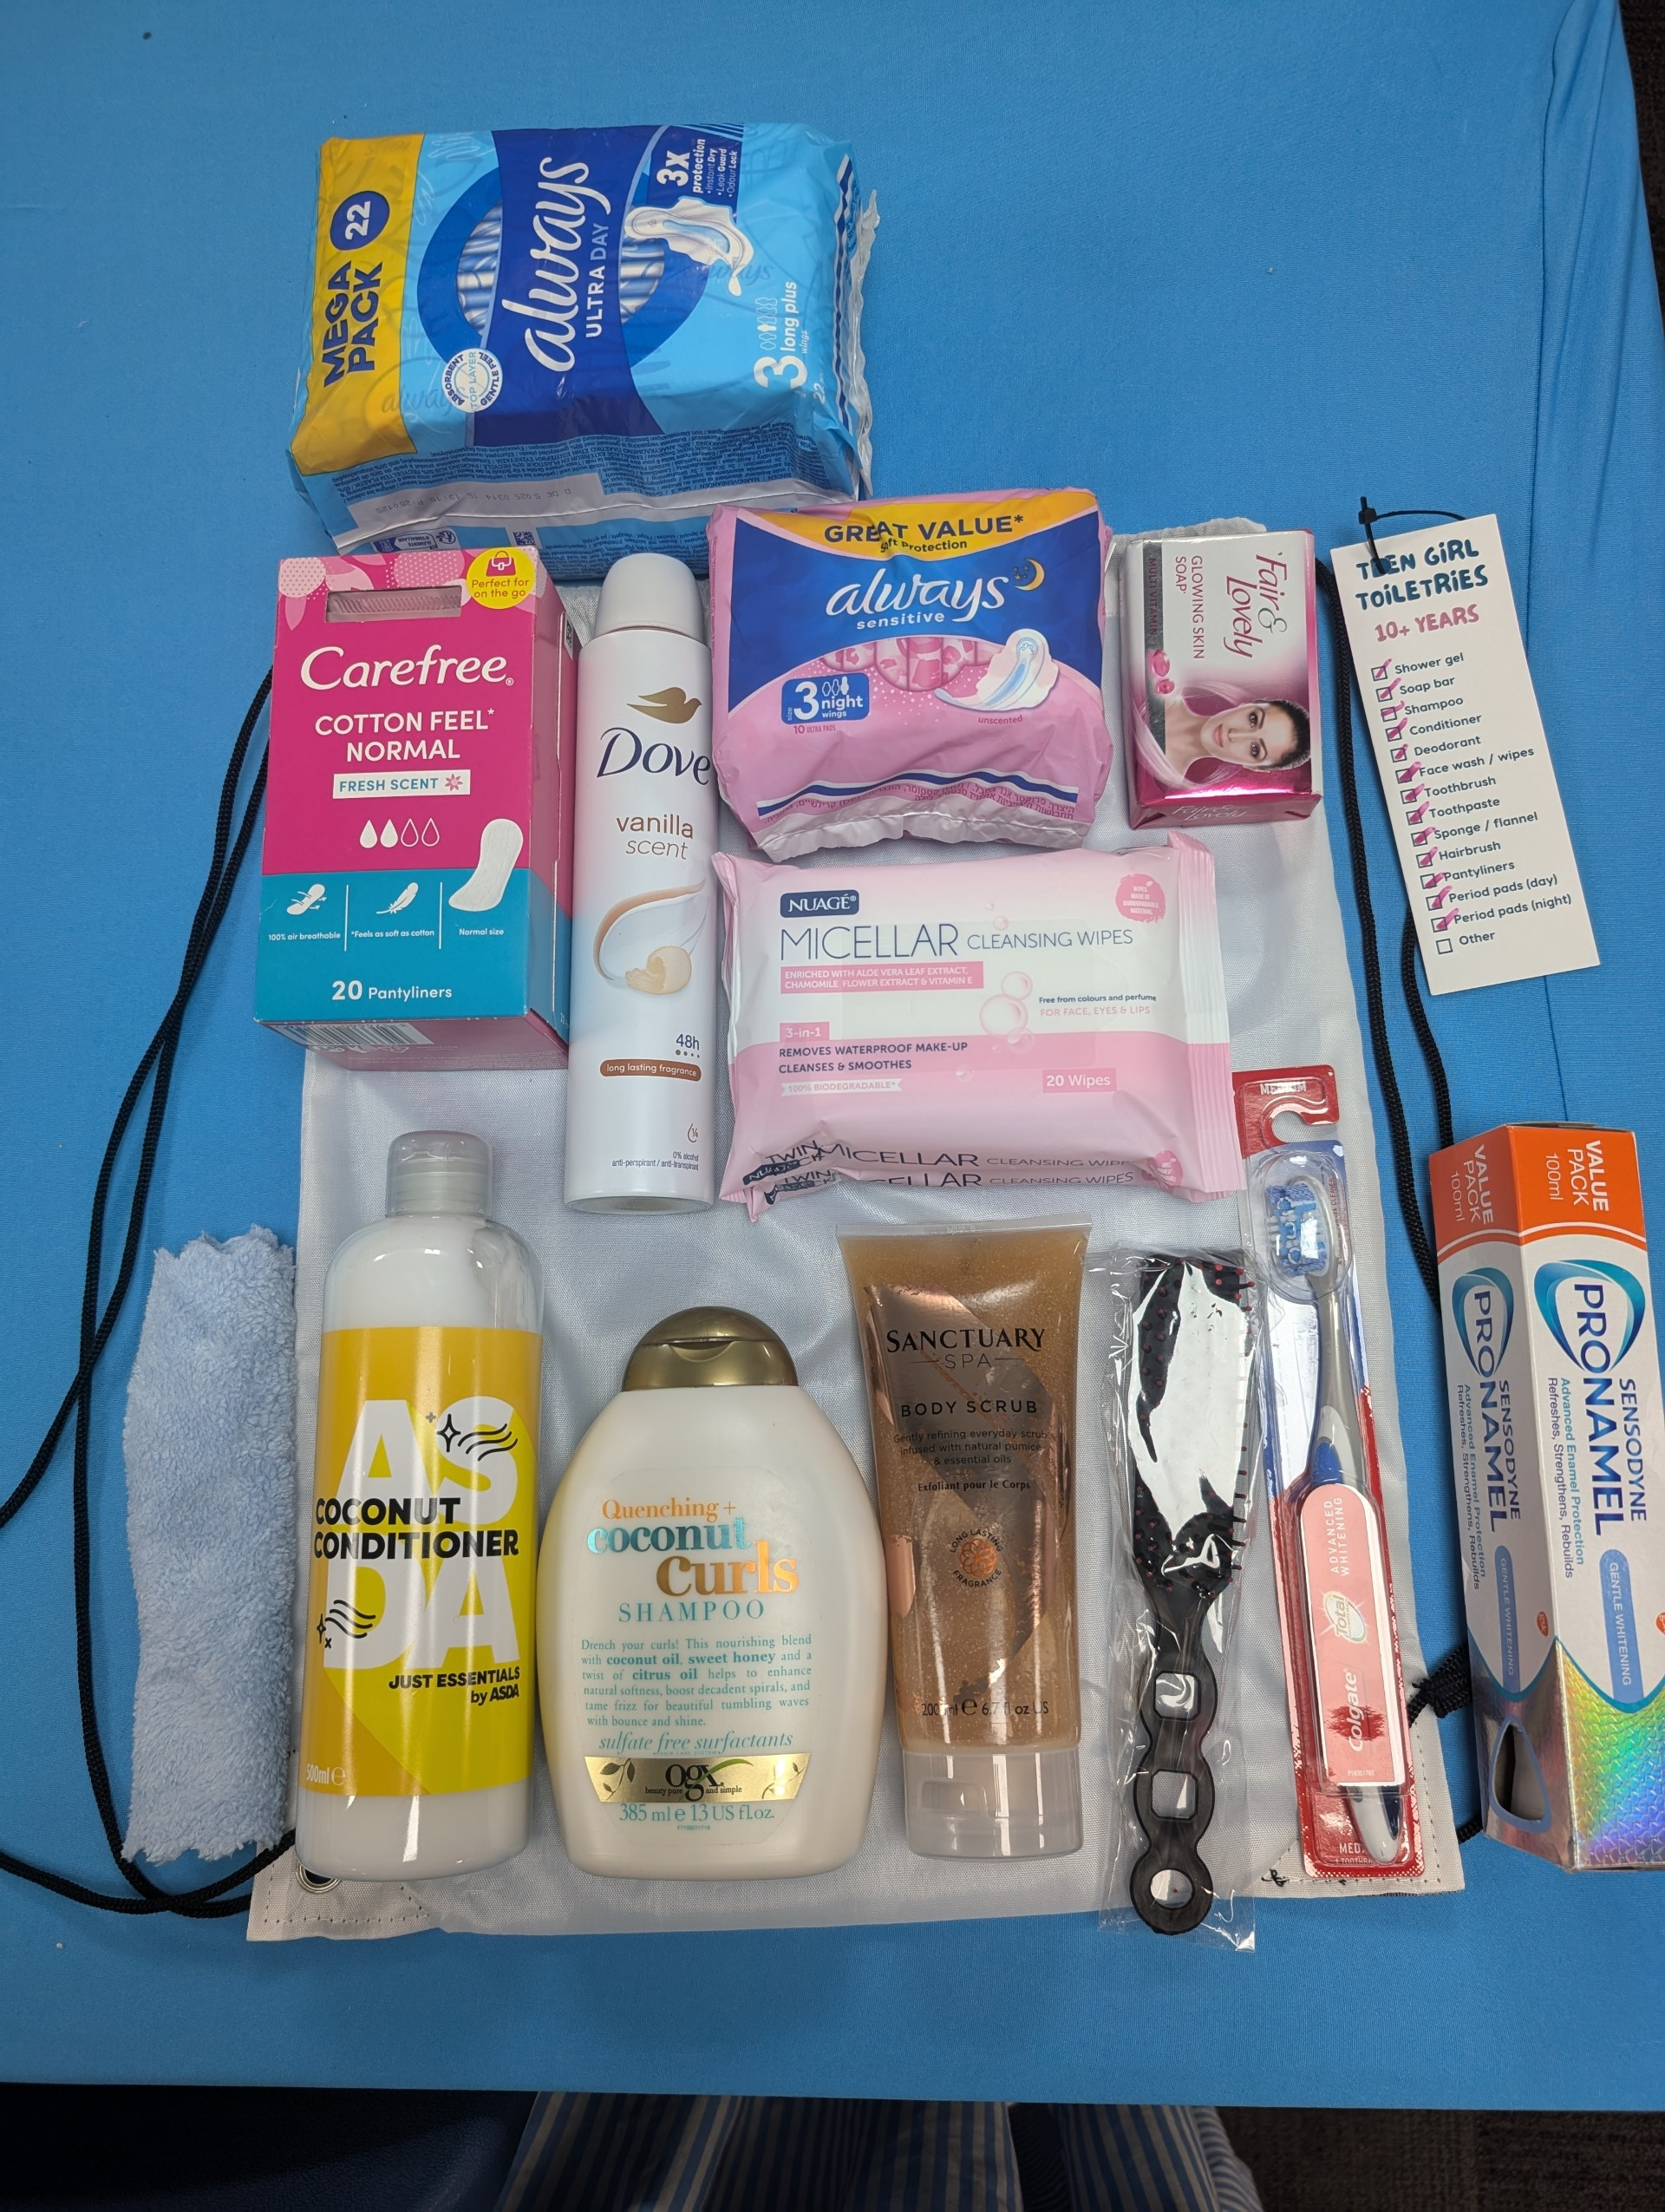
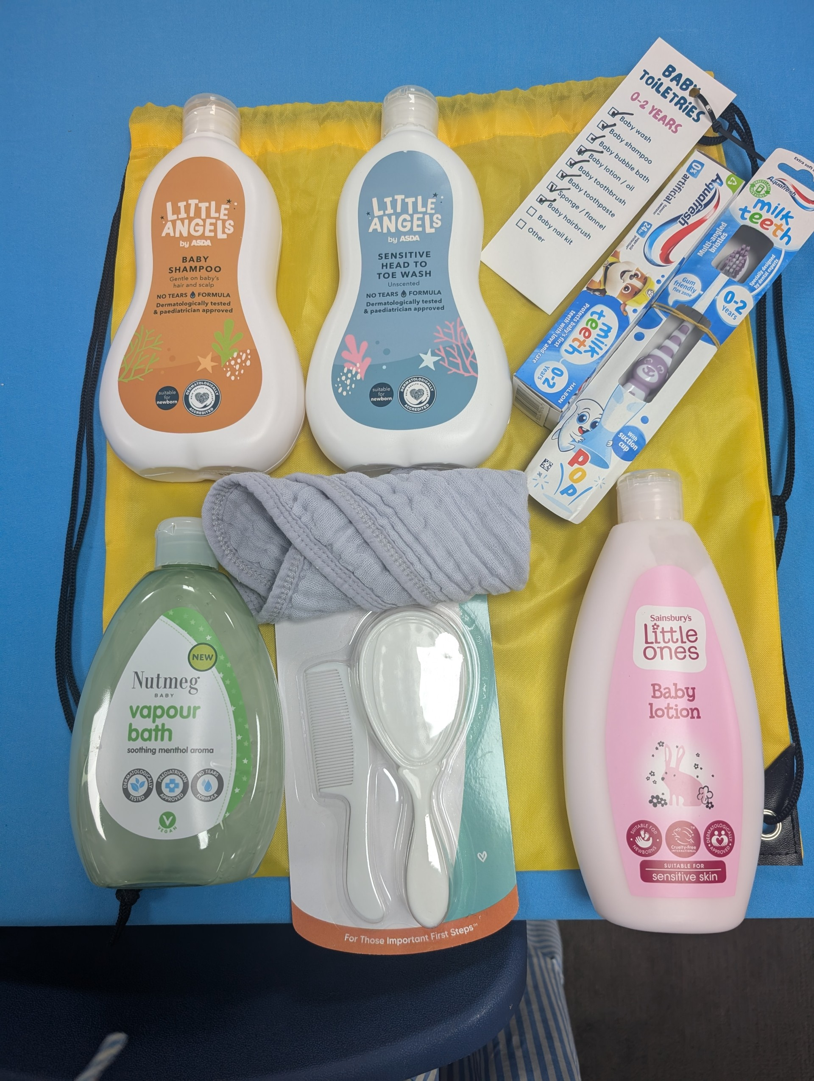
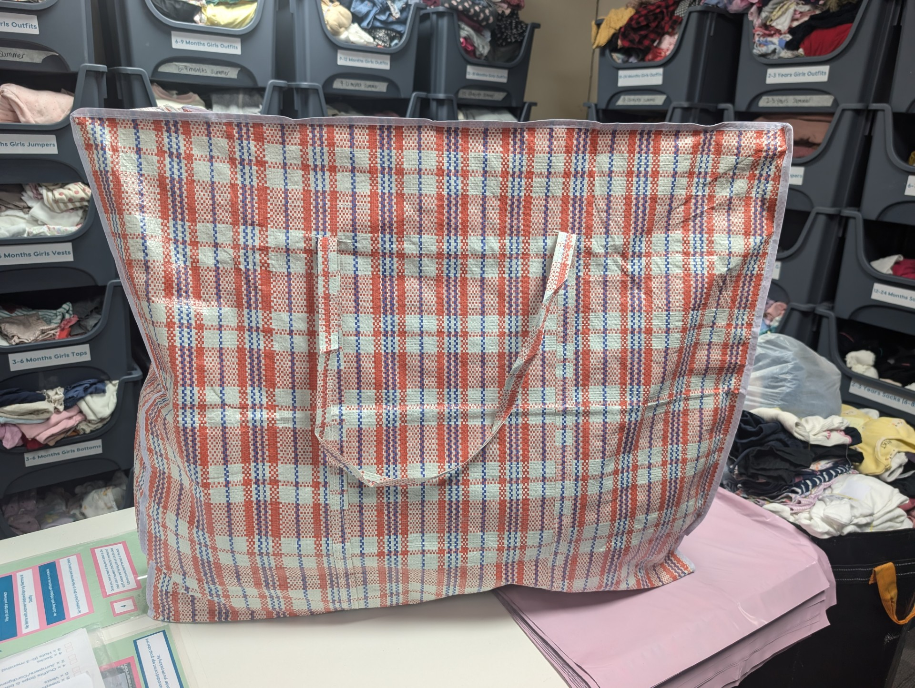
Toiletry pack
One packed referral bag
Families will receive on average around 3 of these bags. Please ensure families are aware of the size and have suitable transport organised to get home.
This is an example toiletry pack, not all items are guaranteed.

Slide 5
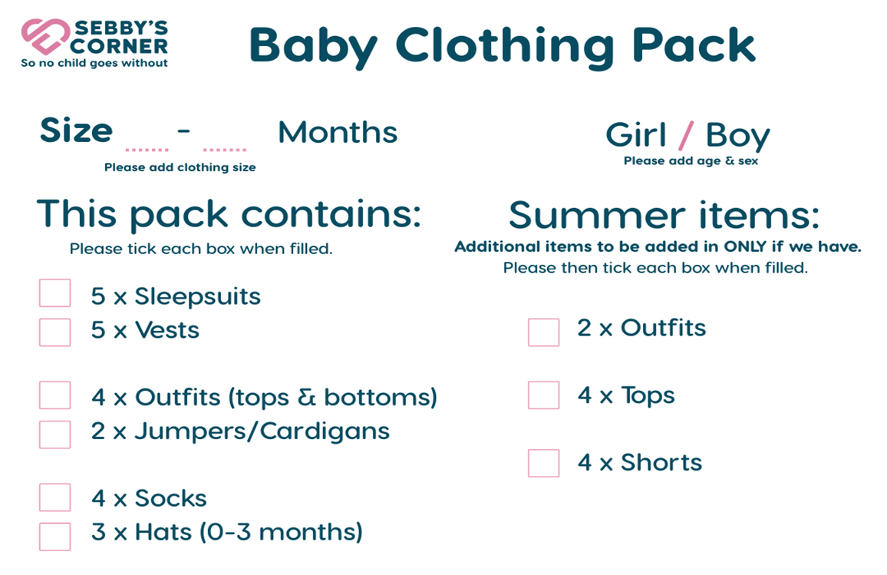
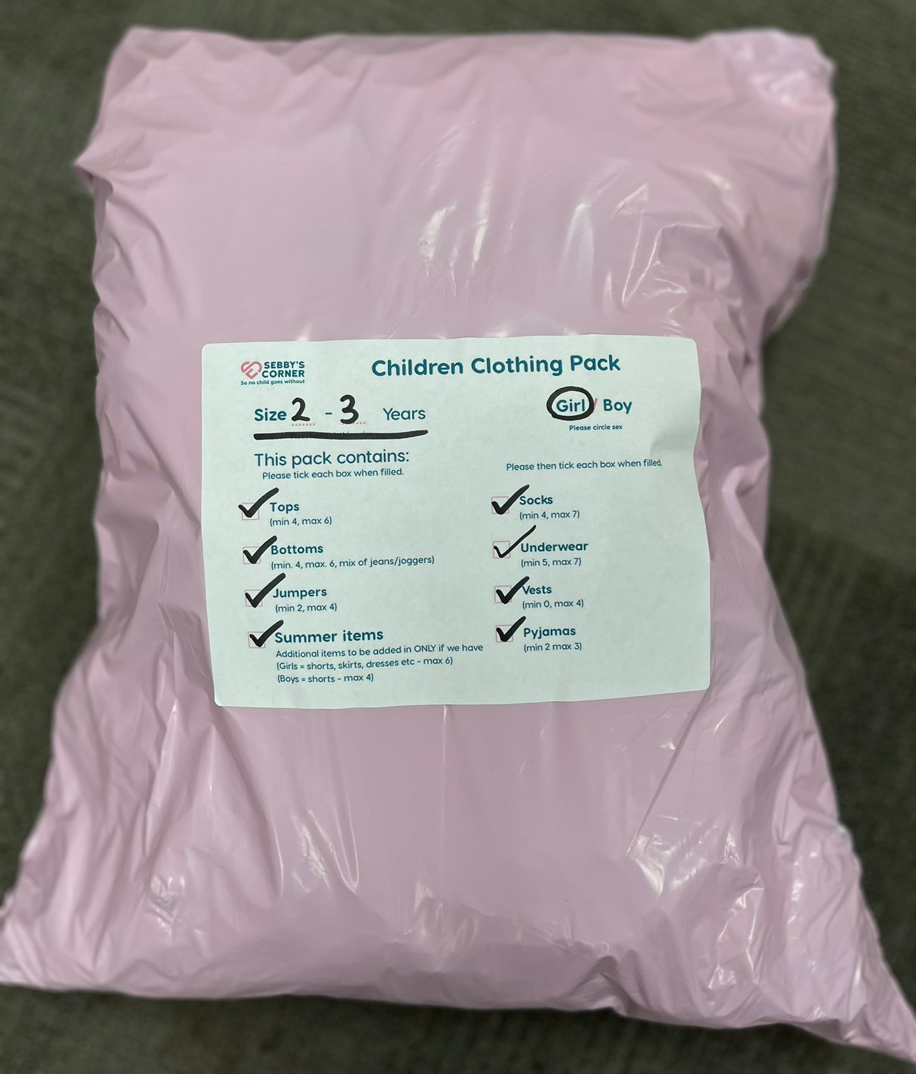
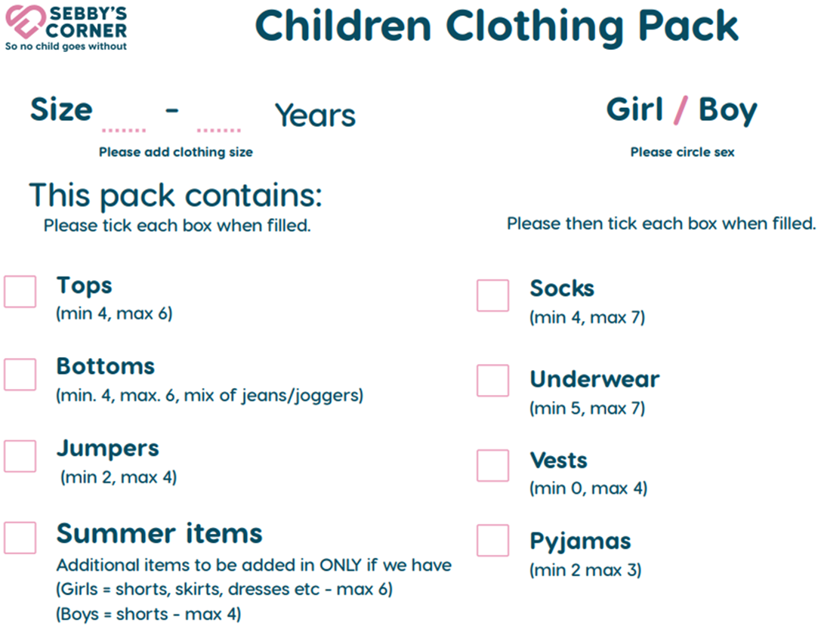
Clothing Pack and Contents

Slide 6
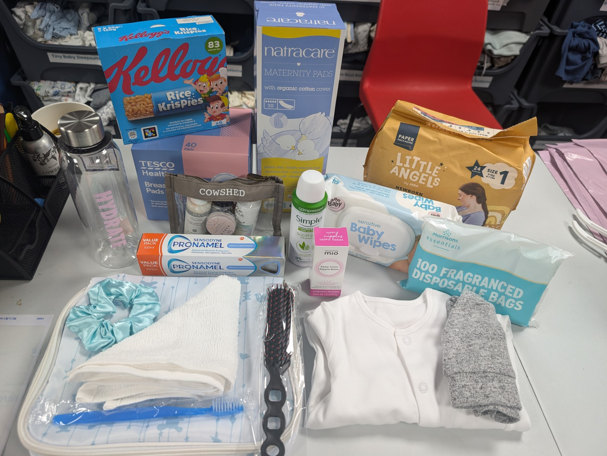
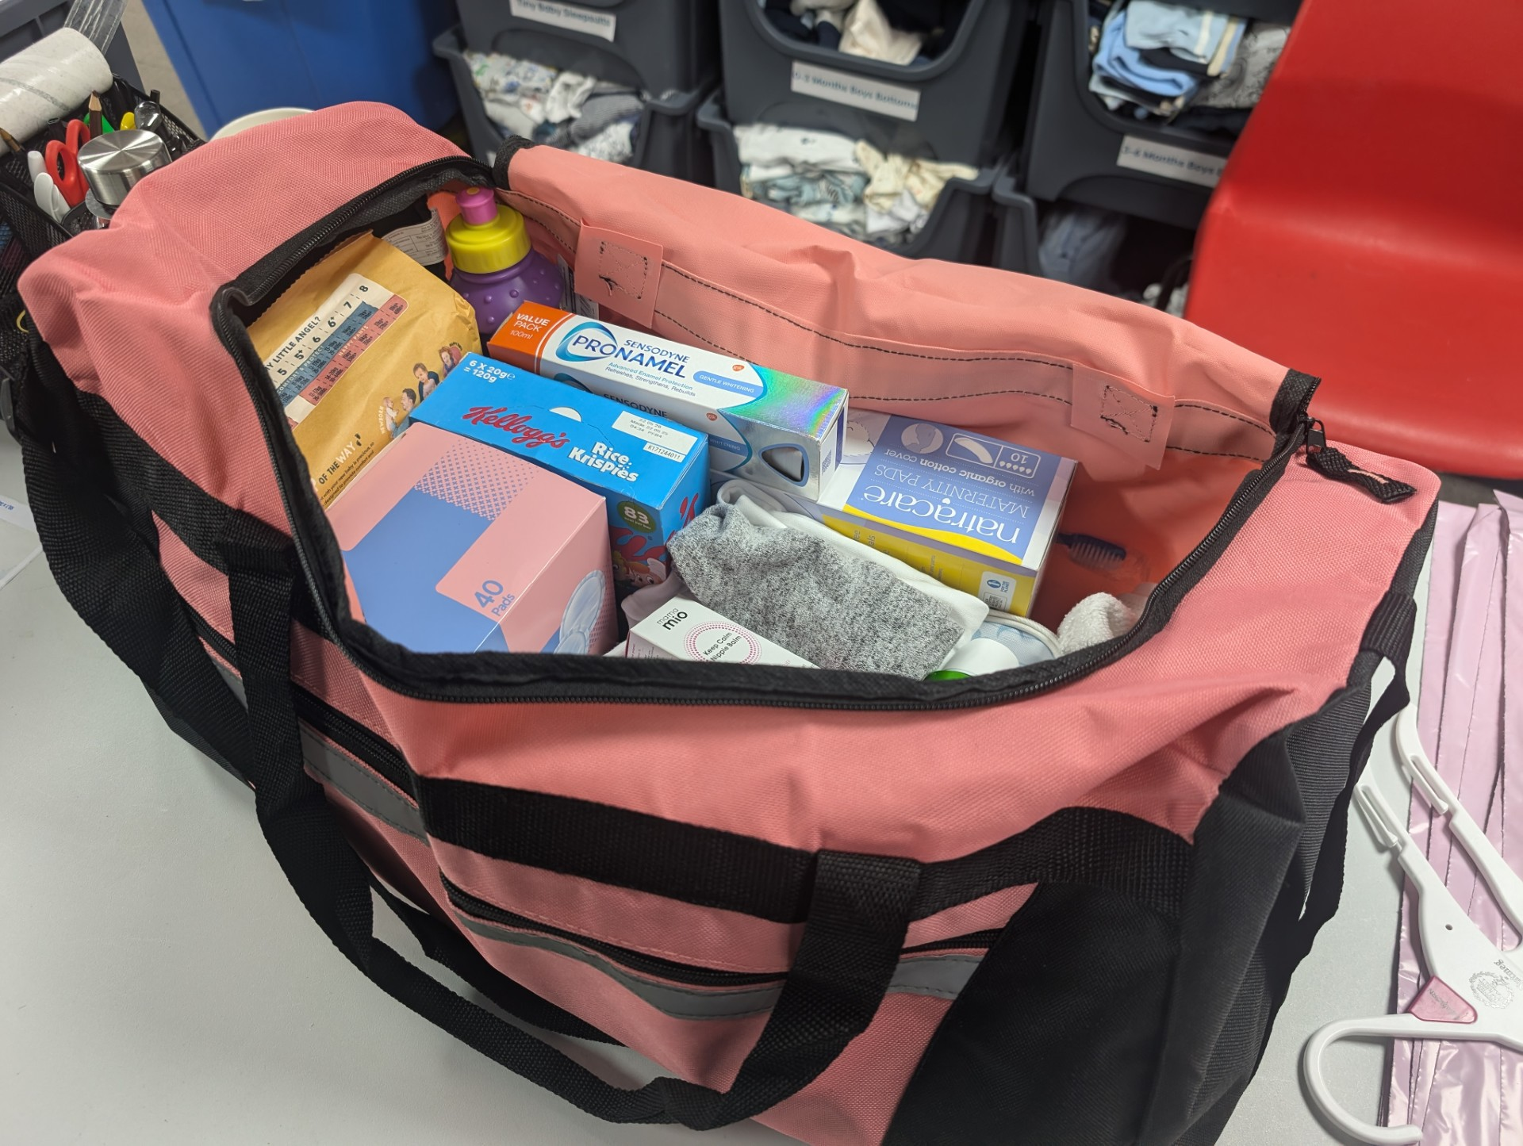
Hospital bag contents
Unisex newborn hat
Unisex newborn clothing
Size 1 nappies
Baby Wipes
Nappy Sacks
Nipple Cream
Breast Pads
Maternity Pads
Flip Flops
Postpartum Underwear
Mini Shower Gel
Mini Deodorant
Mini Shampoo
Mini Conditioner
Toothpaste
Toothbrush
Flannel
Hairbrush
Water Bottle
Snack
Please note, not all items may be available and therefore are not all guaranteed.

Slide 7

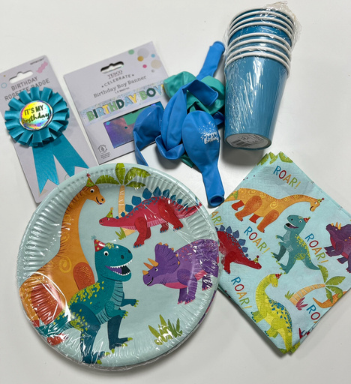
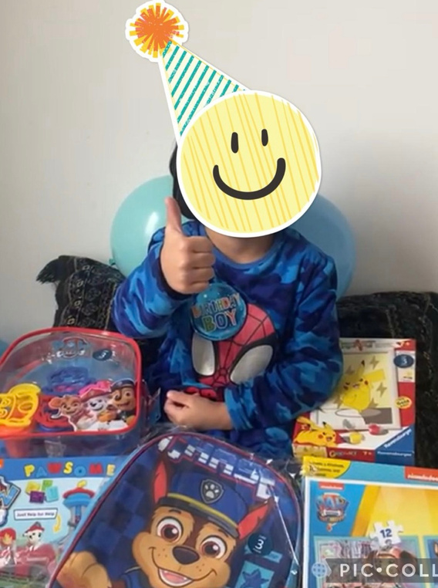
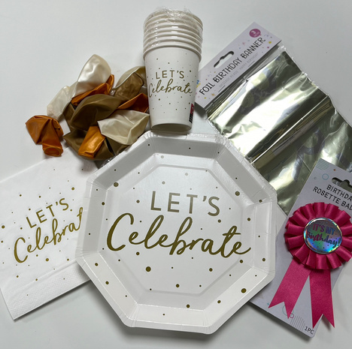
Our Services
Birthday Club
Children who are referred by a registered referral partner will receive a gift, balloons, decorations and a birthday cake. Please note we will do our best but can’t cater to all dietary requirements.
Thanks to the community access scheme we are also able to provide tickets to ZSL London Zoo for the family and their children.
Please note, each child is entitled to one birthday club referral.

Slide 8

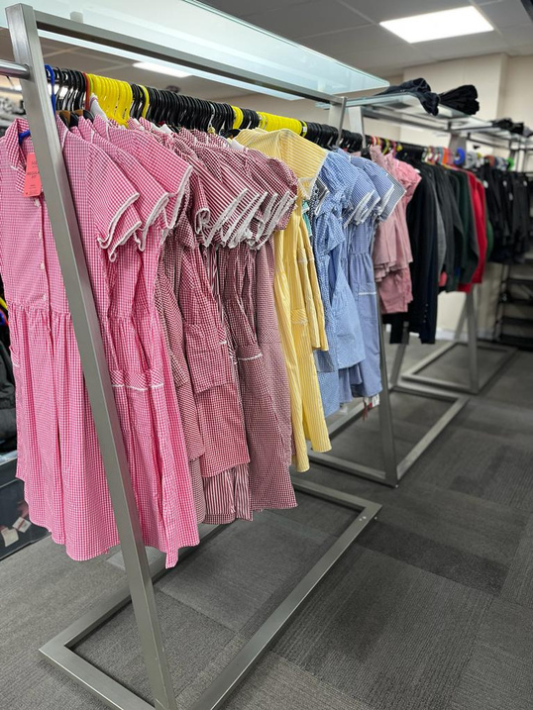
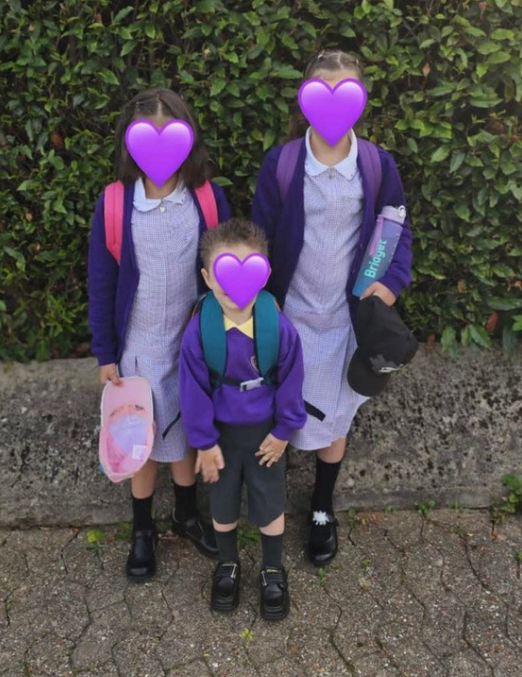
Our Services
School Uniform Support
Families can apply to our free uniform scheme to receive brand new / excellent condition school uniform, school shoes, a school bag and stationery for each of their children.
We open to school uniform referrals in May, and families are welcome to access this support each year if it is required.

Slide 9

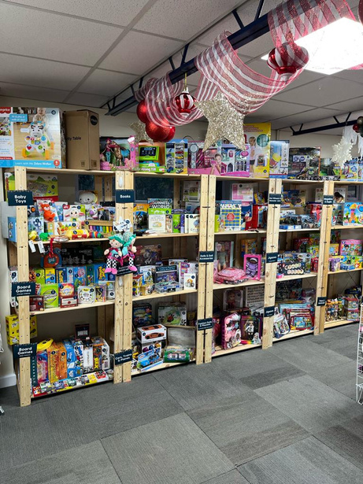
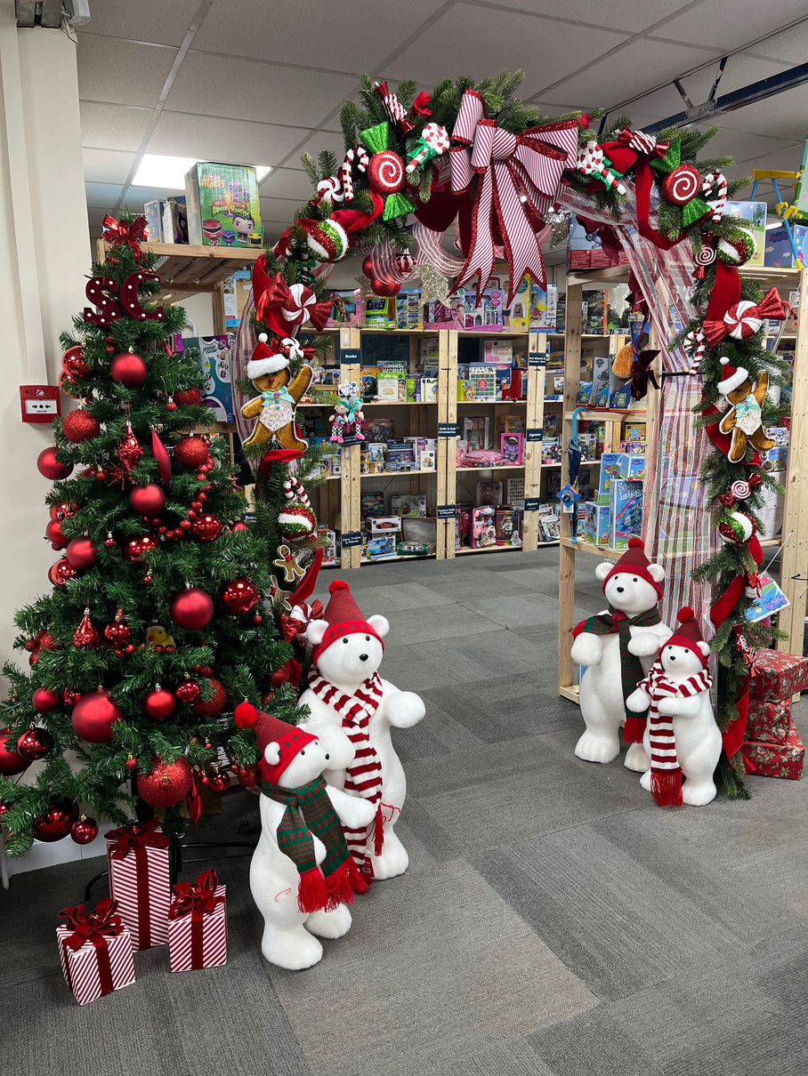
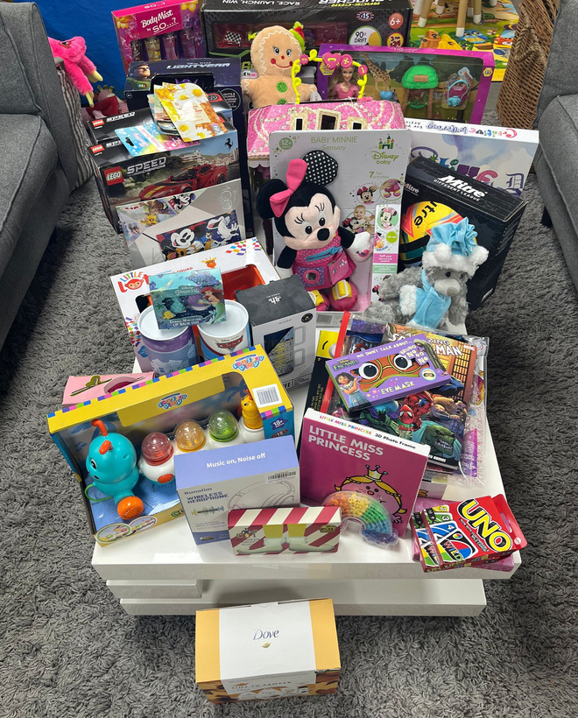
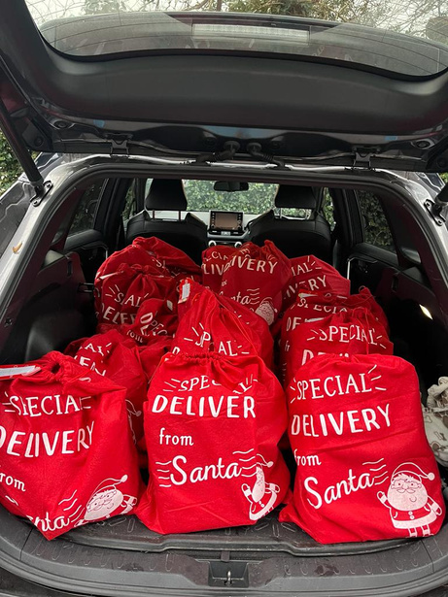
Our Services
Festive Support
Our Festive Support offers parents and caregivers who are struggling, the chance to choose Christmas gifts for their children.
We open for Festive Support referrals in mid October and families are welcome to access this support each year if it is required.
We are also able to support with bulk referrals, we can pre pack these for you based on the ages of the children or you can come and choose the items yourself.

Slide 10



How to become a referral partner:
After registering as a Referral Partner you will receive an ORG number and a RP number; these are essential to make a referral – please make a note of them.
Once you have received you ORG and RP numbers you can refer a family via our online form, also found on our website: - (sebbyscorner.co.uk/essentials-support).
Please note there is an option to ‘Log in’, if you want to create an account you can but you do not need to log in to make a referral.
Please provide as much information as possible about the family including their needs and ages of the children.
Please keep in mind that the demand on our services is very high. To ensure we can help as many families as possible, we ask you to be thoughtful of the amount you are requesting for the family.

Slide 11


Once the form has been completed, you will receive an automated email prompting you to book a prepacked collection appointment. Please note the appointment is NOT accepted until you receive a confirmation from our team.
Essentials Support
For an Essentials Support referral, Sebby’s Corner will …
Check the application and make sure everything requested is age appropriate for the children in the family.
2. If we have the items requested in stock, we will pack them for the family/referral partner.
3. Please ensure the family has suitable transport to get them home. They will have a large number of bags/items meaning public transport isn’t always suitable.

Slide 12

Most families leave Sebby’s Corner with at least 3 large bags full of heavy items plus other equipment, with an average value of £426.30
Please make it clear to families that they will NEED A CAR/TAXI/LIFT HOME as they will not be able to carry it all on public transport unless it is a very small referral e.g. formula. We will be unable to provide transport to families.
Whilst we try our best to accommodate all requests, we can’t guarantee that all items will be in stock and available when a family visits. Please help manage the family’s expectations to avoid disappointment when they collect from us.
Please inform us as soon as possible when you/the family are not able to attend an appointment, so we are able to free it up for another family in desperate need.

Slide 13

New Policies in place for 2025
As demand for our services are at an all time high, we have put in a few new policies:
1. A family can only be referred to us for essentials support a maximum of 3 times.
2. For our birthday club referrals, we can support each child in the family once.
3. We understand that families can’t always attend their appointments, but due to limited space, unless contacted to rearrange a pick-up time, the referral will be unpacked and cancelled within 2 working days.
4. We are happy to support families with a second or third referral, however please note that new referrals can only be made 4 months from the date of collection.

Slide 14
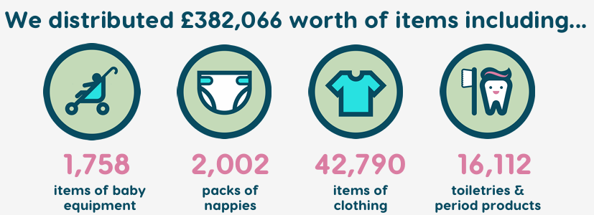
April 2024 to March 2025 Statistics

Slide 15
Thank You
Any Questions?

